Slide 1
Transitioning to Site Reliability Engineering
DevOps Meetup
Scott Clark - Director, R&D
Feb 2017

Slide 2

Agenda
Why the move to Site Reliability Engineering
What does Reliability Engineering look like at Qlik
Some lessons learned as we moved to continuous delivery
Questions

Slide 3

Why the move to Site Reliability Engineering
Built around a Site Reliability Engineering role (Ben Treynor-2003)
From 7 Software Engineers to 1500 Engineers
As part of the overall Quality and Operational Engineering role at Qlik:
Our goal is to protect, provide for and ensure efficient deliveries of our external facing cloud services, while keeping and eye on global availability, cost efficiency, performance and scalability issues.
DevOps is a practice that encompasses automation of manual tasks, continuous integration and continuous delivery.
SRE would be considered a subset of DevOps that possesses additional skill sets.

Slide 4
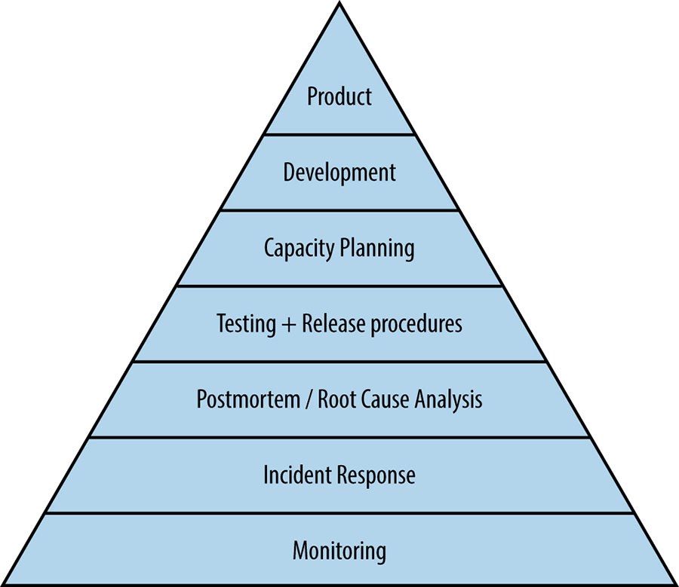
Service Reliability Elements
Now think about the continuous pipeline and the product.
Are you thinking about building to scale.
Automate tests and release processes.
Work to finding new and exciting problems to fix. Don’t fix the same issue twice.
Once you’ve got a problem, how to make it go away.
Don’t fly blind…

Slide 5

Reliability Engineering in Practice at Qlik
We will ensure we build Service Reliability by building excellence around the following pillars:
Production Monitoring and Operations Tools
Incident Tracking and Resolution
Security and Compliance
Cost Optimization
Operational Strategy and Architecture
Third-Tier Customer Support

Slide 6
Production Monitoring and Operations Tools
Improve monitoring to be able to report on Service Performance, User Experience and User Engagement KPIs
Centralized operations management console:
to track the Production health and quality
to control changes to the production environment
Increase automation to improve site reliability and recoverability
Remove regular toil through automation

Slide 7
Incident Management
Disaster Recovery planning and practice events
Runbook management and automation
Chaos monkey scenarios
Monitor infrastructure changes that adversely affect the production recoverability
Notes:
Traction in all frontiers

Slide 8
Security and Compliance
Working with our in-house SSO to ensure threat analysis and implement counter measures where necessary
Stay current with Cloud related security whitepapers
Plan for enterprise grade security
Plan towards SOC-2 certification and compliance.
Notes:
Traction in all frontiers

Slide 9
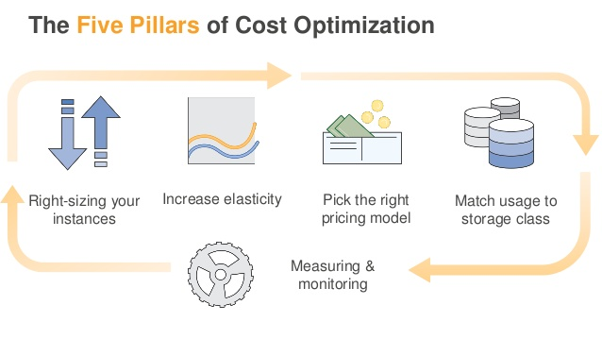
Step 1: Cheap out on the instance available while meeting performance requirements • Use a tool like CloudWatch to gather metrics and setting up custom RAM metrics Rule of thumb: Right size, then reserve.
Notes:
Selecting the cheapest instance available while meeting performance requirements • Looking at CPU, RAM, storage, and network utilization to identify potential instances that can be downsized • Leveraging Amazon CloudWatch metrics and setting up custom RAM metrics Rule of thumb: Right size, then reserve. (But if you’re in a pinch, reserve first.) 2.

Slide 10
Step 2: Look for dev/test, nonproduction instances that are running always-on and turn them off. • Lambda + CloudWatch + ELB = Automated Scheduling
Notes:
Selecting the cheapest instance available while meeting performance requirements • Looking at CPU, RAM, storage, and network utilization to identify potential instances that can be downsized • Leveraging Amazon CloudWatch metrics and setting up custom RAM metrics Rule of thumb: Right size, then reserve. (But if you’re in a pinch, reserve first.) 2.

Slide 11
Step 3: Plan for Reserved Instances - Saving are significant (1 YR-40% 3 YRS-60%) especially when you pay costs upfront BUT Where possible – use spot instances on transient workloads! On average an 87% discount!
Notes:
Selecting the cheapest instance available while meeting performance requirements • Looking at CPU, RAM, storage, and network utilization to identify potential instances that can be downsized • Leveraging Amazon CloudWatch metrics and setting up custom RAM metrics Rule of thumb: Right size, then reserve. (But if you’re in a pinch, reserve first.) 2.

Slide 12
Step 4: Be careful about overpaying for storage!!! Do you really need the data set retrieved that fast???
Notes:
Selecting the cheapest instance available while meeting performance requirements • Looking at CPU, RAM, storage, and network utilization to identify potential instances that can be downsized • Leveraging Amazon CloudWatch metrics and setting up custom RAM metrics Rule of thumb: Right size, then reserve. (But if you’re in a pinch, reserve first.) 2.

Slide 13
Step 5: Monitor / Monitor / Monitor
Notes:
Selecting the cheapest instance available while meeting performance requirements • Looking at CPU, RAM, storage, and network utilization to identify potential instances that can be downsized • Leveraging Amazon CloudWatch metrics and setting up custom RAM metrics Rule of thumb: Right size, then reserve. (But if you’re in a pinch, reserve first.) 2.

Slide 14
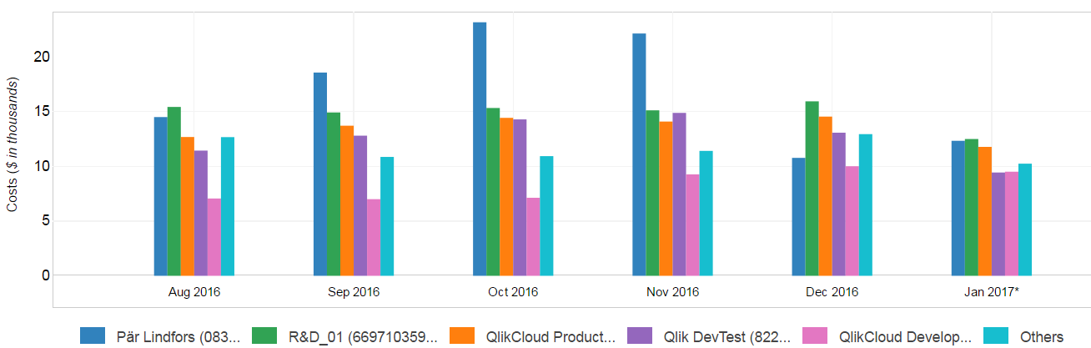
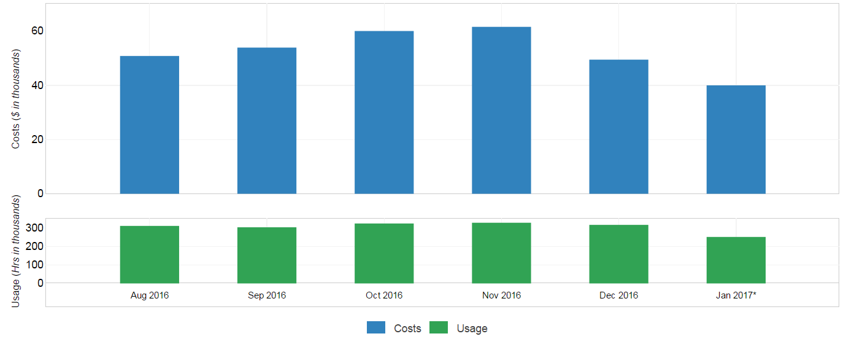
!!!
Notes:
Traction in all frontiers

Slide 15
Operations Strategy and Architecture
Provide cloud impact assessment of all cloud deployed product scenarios
Ensure we are structured to provide optimal feedback to development teams delivering to the cloud
Continue to research alternate architectures and report back to appropriate parties
Research requirements for best of breed Production and Reliability tools
Ensure we are built for optimal cost and reliability.
Notes:
Traction in all frontiers

Slide 16
Third Tier Customer Support
Provide the most efficient conduit between the end customer and our disparate development resources
Communicate the features being delivered through the Cloud Delivery Pipeline to affected stakeholders
Conduct regular triage to ensure we are on top of all customer issues
Monitor community sites and ensure close communication with Concierge and Technical Support organizations
Perform ongoing maintenance when required
Regularly monitor production errors.
Notes:
Traction in all frontiers

Slide 17

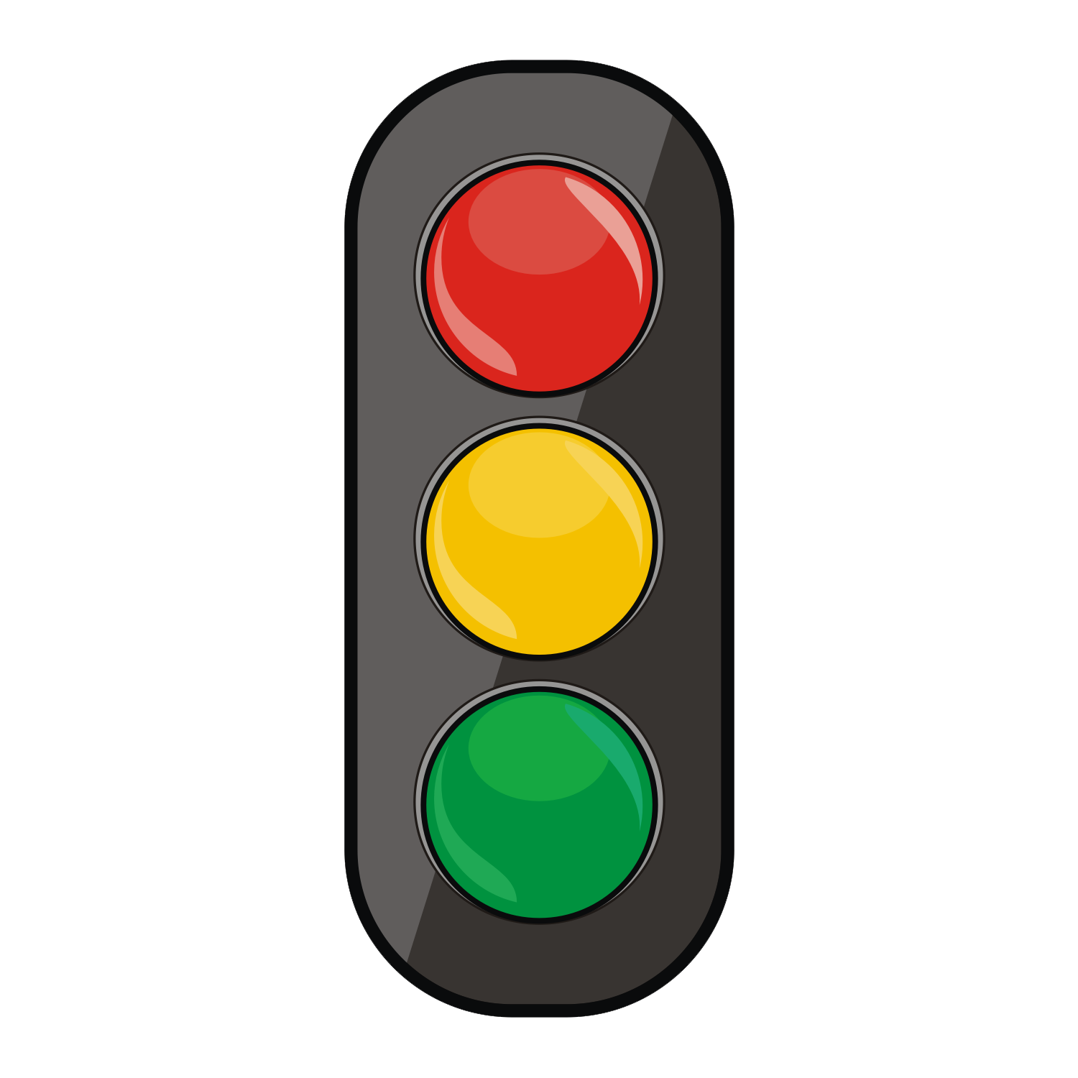
Our Qlik Cloud Release Lesson’s Learned
We didn’t respect Staging and used it as our testing environment (not Production)
Late Friday deploys are bad
Implementing features without the ability to measure
Large commits in development cornered us
Feature Flags need to be used for every new feature
New features without associated automated tests
Production Status – Where does Champions league kick into gear.

